Slide 1
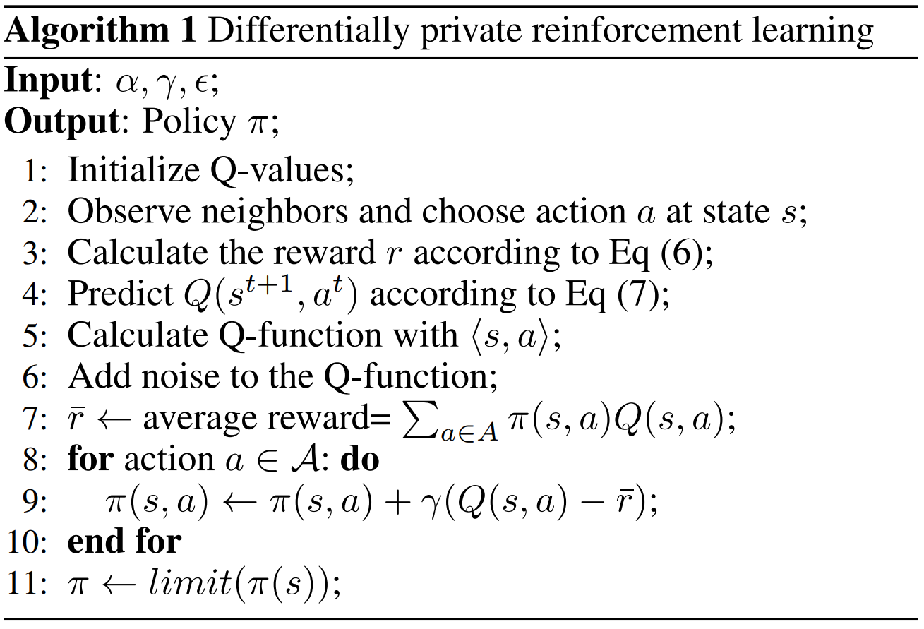
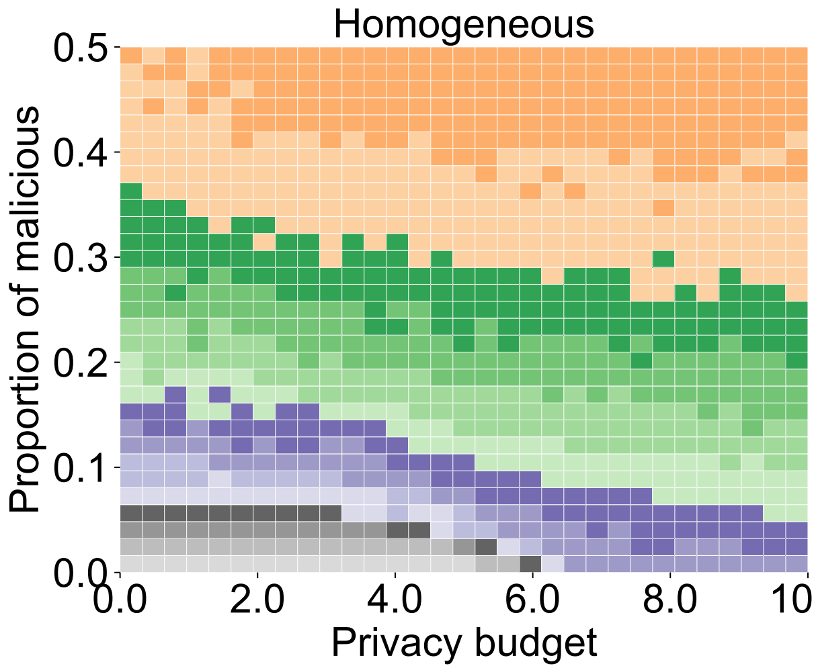
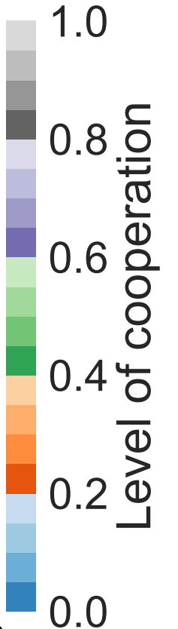
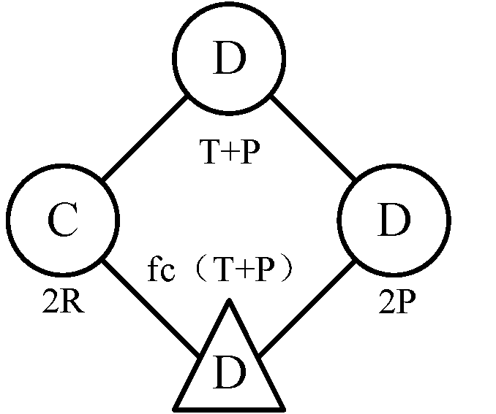
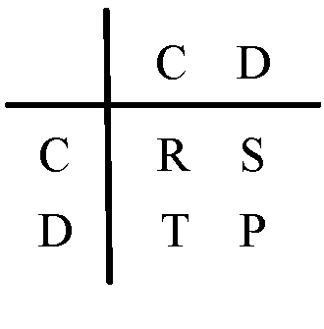
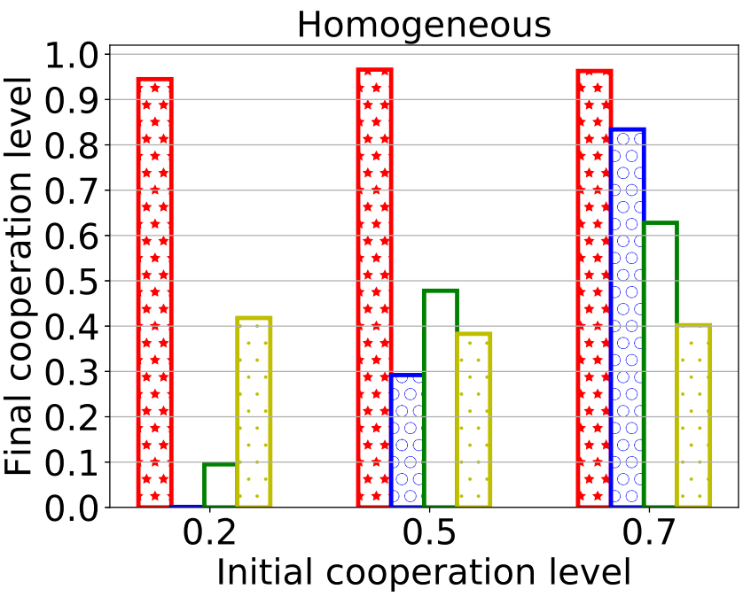
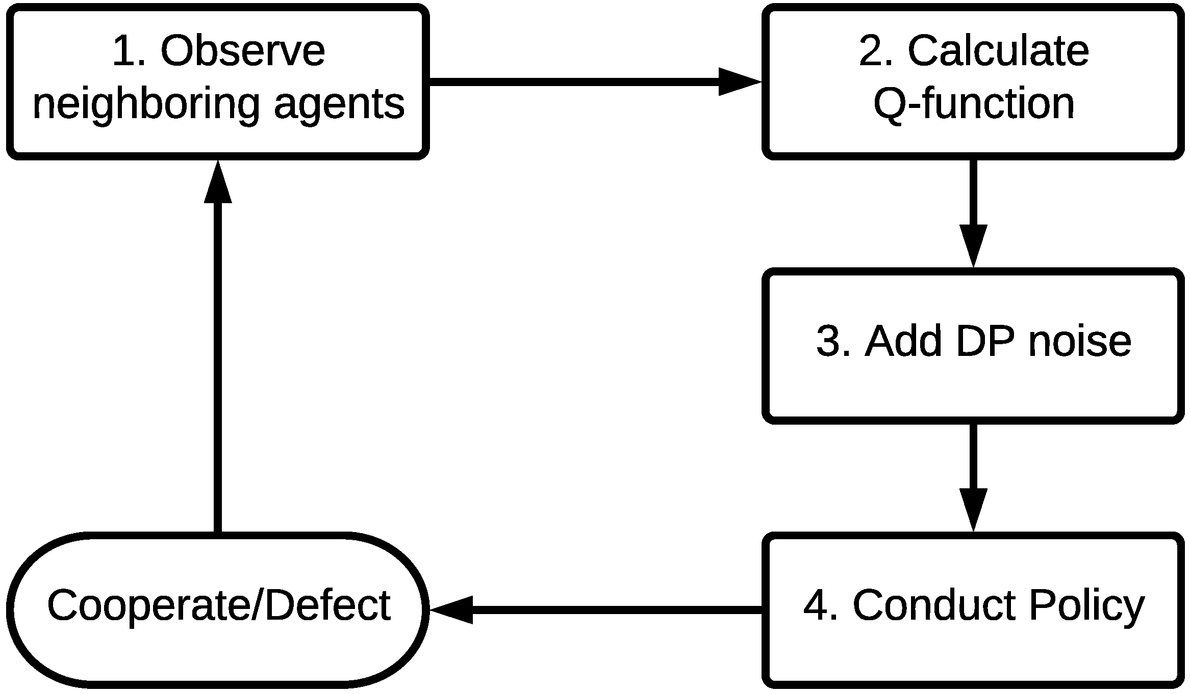
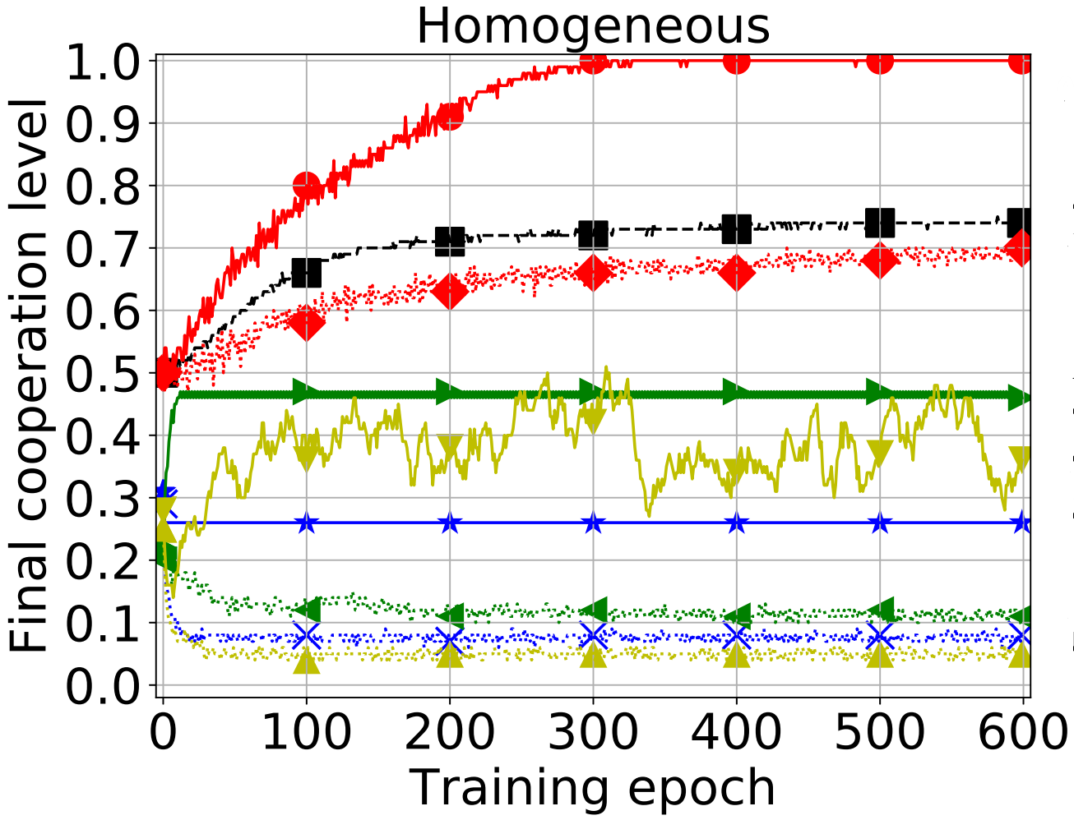
Differential Private Reinforcement Learning
for the Evolution of Cooperation
Tao Zhang, Dayong Ye, Tingting Liao, Tianqing Zhu, Wanlei Zhou
School of Software Engineering
Abstract
Model description
Designing mechanisms that promotes the level of cooperation between agents has been a challenge in multiagent systems. Existing mechanisms have two common drawbacks. The first drawback is that malicious agents are not taken into account. Malicious agents can exist in multiagent systems and they can easily degrade the level of cooperation by interfering agents’ actions. The second drawback is that most existing mechanisms have limited adaptivity. The performance of existing mechanisms heavily depends on some factors, such as network structures, the initial proportion of cooperators, and so on.
To solve these two drawbacks, we propose a novel mechanism which adopts differential privacy and reinforcement learning. Differential privacy can resist the impact of malicious agents by exploiting the property of randomization. Reinforcement learning enables agents to learn how to make decisions in various situations. In this way, the stability and adaptivity of the mechanism can be enhanced to promote the evolution of cooperation.
Figure 1a is a simple network, showing the interaction between agents, where agents correspond to nodes, and links correspond to the connection. Two types of agents are considered in the system: common agents (Circle) and malicious agents (Triangle), and they interact with each other independently and simultaneously whether they decide to Cooperate (C) or Defect (D).
Figure 1: (a) Interactions between diverse agents in the PD game
(b) Payoff matrix
Algorithm 1 describes our DP-RL approach. The goal of our algorithm is to learn a policy, which tells agents how to cooperate with others in the iterated PD game.
Figure 4: The impact of varying privacy budgets and the proportion of malicious agents on the evolution of cooperation
Introduction
Figure 1b is the payoff matrix. When agents cooperate with each other, they receive Reward payoff (R); when they defect with each other, they receive the Punishment payoff (P). When one agent chooses to cooperate and the other chooses to defect, the first one receives the Sucker payoff (S) and the second one receives the Temptation payoff (T).
Results
Cooperation is an essential behavior in multiagent systems (MAS). Many tasks in artificial intelligence (AI) require the collaboration of multiple agents. The problem of cooperation is often illustrated as the issue in the iterated prisoner’s dilemma (PD) game in MAS, in which the Nash equilibrium cannot provide a desirable learning target.
Until now, a large body of mechanisms that have been proposed to motivate the evolution of cooperation, e.g., direct mechanisms and indirect mechanisms. Since learning is a popular method applied in MAS, RL has also been investigated in the iterative PD game for the evolution of cooperation in MAS.
Generally, recent work has two challenges: 1) how should the evolution of cooperation resist the impact caused by malicious agents in MAS; 2) how should the evolution of cooperation adapt in various scenarios.
Three baselines, Imitate-Best-Neighbor (IBN), Imitate-Best-Strategy (IBS) and Local-Redistribution-Strategy (LRS) are considered in three types of networks.
The goal of our scheme is to improve the evolution of cooperation with a desirable stability and adaptivity. Stability is tested with two variables - the proportion of malicious agents and the scale of DP noise. Adaptivity is tested with two variables - the initial cooperation level and structured networks.
Method
Figure 5: The adaptivity on structured networks and initial proportion
of cooperators for four mechanisms
Contribution
Conclusion
Figure 2: General description of the method
we mainly focus on two problems 1) the impact of malicious agents in MAS; 2) the impact of the structured networks and the initial proportion of cooperators.
To overcome these problems, we design DP-RL mechanism to enable the evolution of cooperation in MAS. The reinforcement learning method can learn the benefits of direct mechanisms and indirect mechanisms by updating the designed Q-function. More importantly, we apply differential privacy to adjust the agents’ action in order to resist the impact of malicious agents.
The experimental results prove that our proposed mechanism can improve the evolution of cooperation with a reliable stability and adaptivity in different scenarios.
We firstly use the property of randomization in differential privacy to relieve the impact of malicious agents on the evolution of cooperation. This helps agents make decisions to resist the interference by malicious agents.
We design a mechanism for the evolution of cooperation based on RL, which combines the advantages of direct and indirect mechanisms. This provides a desirable adaptivity to fit various conditions in MAS.
We theoretically analyze our proposed mechanism and conduct experiments to validate the effectiveness of proposed mechanism.
Figure 2 shows a general description of how agents make decisions in terms of RL when interacting with other neighboring agents in the evolution of cooperation. The design of the Q-function in Step 2 and the application of DP noise in Step 3 are two crucial steps.
In step 2, we design the reward in Q-function which includes the agent’s payoff and its neighbors’ payoff. The expected reward is designed to consider the neighboring agents’ historic behaviors.
In step 3, we use the property of randomization in differential privacy to adjust agents’ actions.
Figure 3: The stability to resist the impact by malicious agents for four mechanisms

